Slide 1
Behavior-driven development

Slide 2
Have you ever heard about BDD?
Notes:
Moje zkusenosti

Slide 3
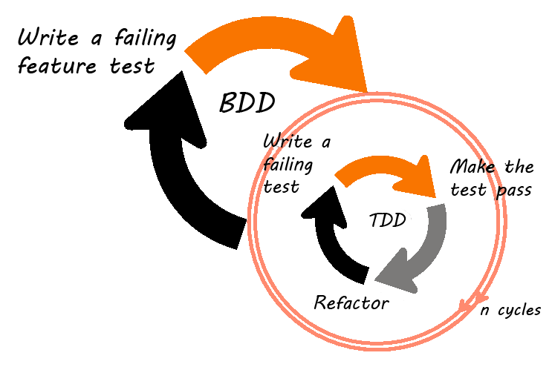
Flow
Notes:
Nadstavba TDD
Ucelem prednasky neni flow ale technicke pouziti
Feature test – diva se na system jako na celek, narozdil od unit testu

Slide 4
Purpose?

Slide 5
Communication!
and testing
Notes:
Komunikace mezi zakaznikem a vyvojarem
2 urovne
1] pri sjednavani feature
2] pro management a ukazani ze vsechno mame krasne zeleny

Slide 6
How it works?

Slide 7
Stories!

Slide 8
Story
Is written in non-technical language
Contains
Narrative
Scenarios
Given
When
Then
Notes:
Povidani na zacatku
Scenare, kazdy scenar
Given – pocatecni context
When – kdyz neco
Then – tak neco

Slide 9
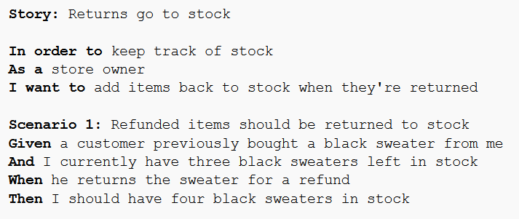
Notes:
Vytvarim spolu se zakaznikem
Nadpis > povidani > scenare

Slide 10
Step 2 Map steps to code
Notes:
Namapovat scenare do kodu
Given – When - Then

Slide 11
Step 3 Run tests

Slide 12
Step 4 Check your cool reports

Slide 13
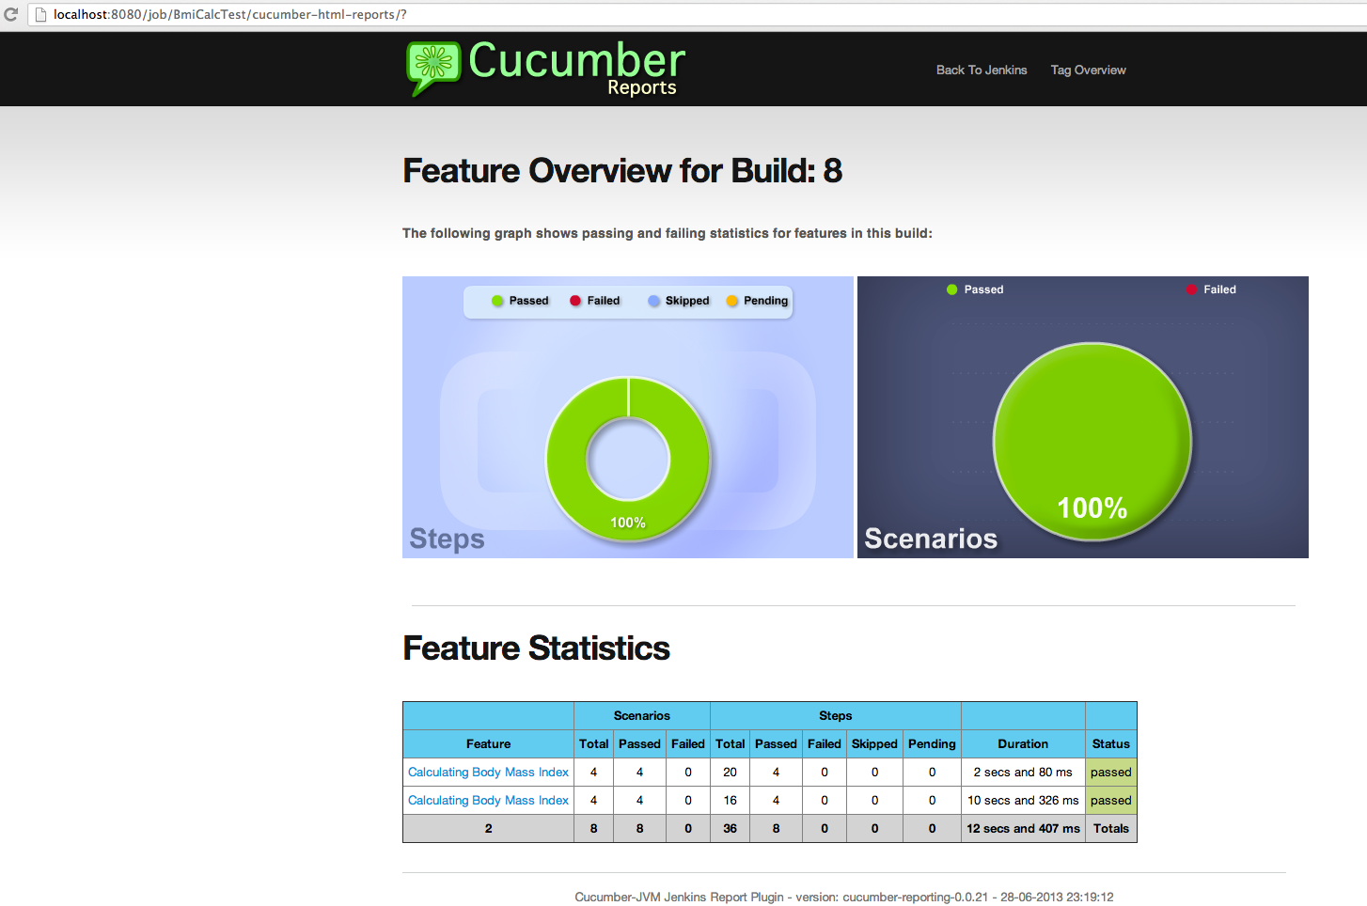

Slide 14
It’s about tools
JBehave
Cucumber
Behat
RSpec
Jasmine
NBehave
…
Notes:
Jbehave – java, prvni
Cucumber – Ruby (plno nadstaveb vc. javy)
Behat – PHP
RSpec – ruby
Jasmine – Javascript
Nbehave - .NET

Slide 15
Let’s see

Slide 16
What do you think?
Notes:
Blbost / Zajimavy / Nepouzitelny / Skvely ???
Byl by zajem o dalsi prednasku vice do hloubky ?
Zamyslet se nad praktickym vyuzitim ve YSoftu

